Slide 1
Digital Systems
18B11EC213
Latches

Slide 2
Contents
Introduction
Memory Elements
Pulse Triggered Latches
  Active-High S-R Latch
  Active-Low S-R Latch
  Gated S-R Latch
  Gated D Latch

Slide 3
Introduction
A sequential circuit consists of a feedback path, and employs some memory elements.
Combinational outputs
Memory outputs
Combinational logic
Memory elements
External inputs
Sequential circuit = Combinational logic + Memory Elements

Slide 4
Introduction
There are two types of sequential circuits:
  synchronous: outputs change only at specific time
  asynchronous: outputs change at any time
Multivibrator: a class of sequential circuits. They can be:
  bistable (2 stable states)
  monostable or one-shot (1 stable state)
  astable (no stable state)
Bistable logic devices: latches and flip-flops.
Latches and flip-flops differ in the method used for changing their state.

Slide 5
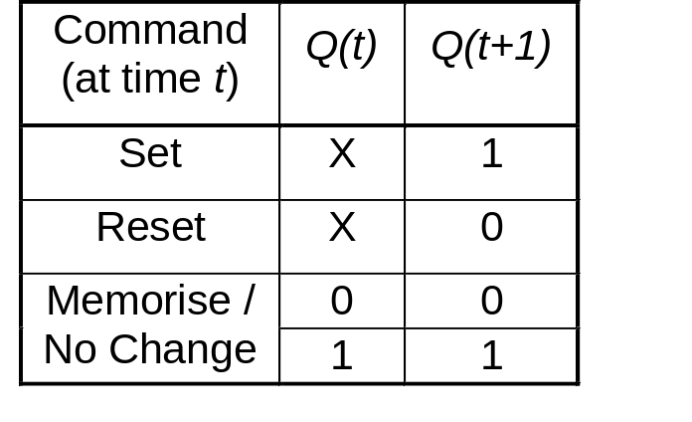
Memory Elements
Memory element: a device which can remember value indefinitely, or change value on command from its inputs.
Characteristic table:
Memory element
Q
command
stored value
Q(t): current state
Q(t+1) or Q⁺: next state

Slide 6
Memory Elements
Memory element with clock. Flip-flops are memory elements that change state on clock signals.
Clock is usually a square wave.
Memory element
Q
command
stored value
clock
Positive pulses
Positive edges
Negative edges

Slide 7
Memory Elements
Two types of triggering/activation:
  pulse-triggered
  edge-triggered
Pulse-triggered
  latches
  ON = 1, OFF = 0
Edge-triggered
  flip-flops
  positive edge-triggered (ON = from 0 to 1; OFF = other time)
  negative edge-triggered (ON = from 1 to 0; OFF = other time)

Slide 8
S-R Latch
Complementary outputs: Q and Q'.
When Q is HIGH, the latch is in SET state.
When Q is LOW, the latch is in RESET state.
For active-HIGH input S-R latch (also known as NOR gate latch),
R=HIGH (and S=LOW) a RESET state
S=HIGH (and R=LOW) a SET state
both inputs LOW a no change
both inputs HIGH a Q and Q' both LOW (invalid)!

Slide 9
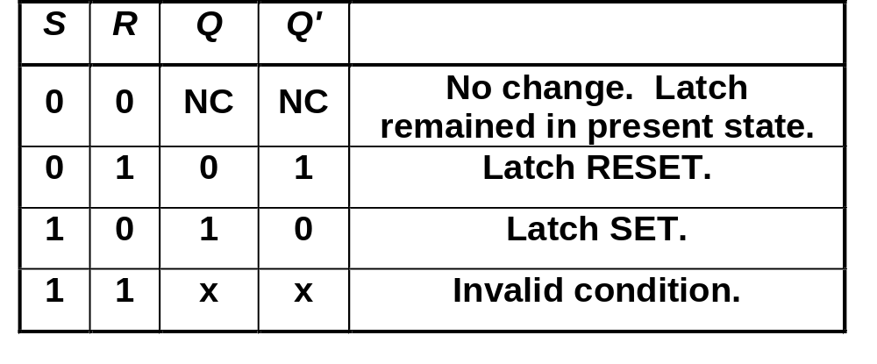
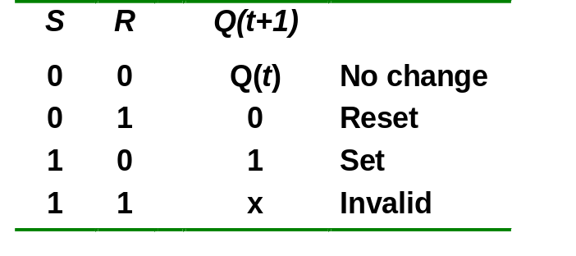
Active-High S-R Latch
Characteristics table for active-high input S-R latch:

Slide 10
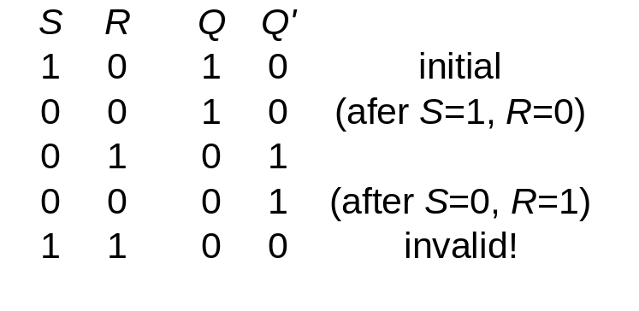
Active-High S-R Latch
Active-HIGH input S-R latch
1
0
1
0
0
R
1
1
0
0
Q
0
Q'
0
0
1
1
1
0
0
0
0
1
S

Slide 11
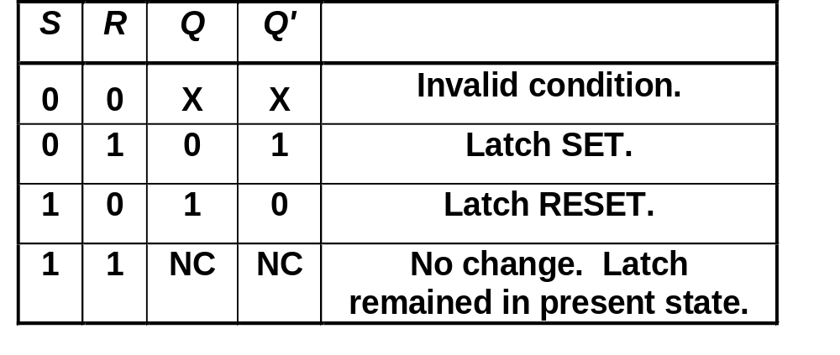
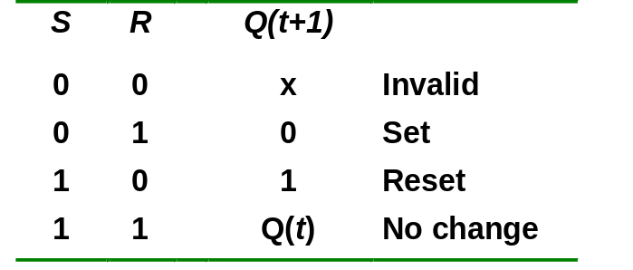
Active-Low S-R Latch
Characteristics table for active-low input S-R latch (also known as NAND gate Latch):
R
Q
S
Q'

Slide 12
Active-High S-R Latch using NAND
An active-Low NAND latch can be converted into active-High NAND latch by inserting the inverters at S and R inputs.
S
Q
R
Q'

Slide 13
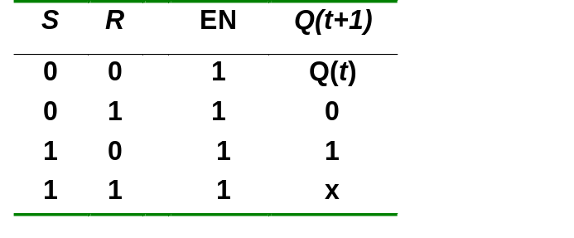
Gated S-R Latch
In the latches described earlier, the output can change states at any time the input conditions are changed. So, they are called asynchronous latches.
A gated S-R latch uses Enable (EN) input. The S and R inputs control the state of the latch only when the EN is high.
The gated S-R latch is also called clocked S-R latch or synchronous S-R latch.
S
EN
Q
Q'
R
S
Q
EN
Q'
R

Slide 14
Regular vs. Gated S-R latches
Assume that latches have no time delay (ideal)
R
R
R
Q
Q(enabled)
R
Q
Q(regular)
S
S
S
Q
S
Q
En
En
S
Set
Set
Set
R
Reset
Reset
En
Q
(regular)
Q
(enabled)
Gated latch only changes when enable is asserted

Slide 15
Clocking a Gated S-R Latch
R
R
Q
Q
S
S
Q
Clock
En
Clock
(En)
S
Set
Set
Set
R
Reset
Reset
Q
A clocked S-R latch follows the S/R inputs when the clock is asserted.
A clocked S-R latch stores the value when the clock goes low when
the clock is not asserted.

Slide 16
Gated D Latch
Make R input equal to S' → gated D latch.
D latch eliminates the undesirable condition of invalid state in the S-R latch.
D
R
Q
S
En
Q
D
EN
Q
Q'
clk
D
Q
EN
Q'

Slide 17
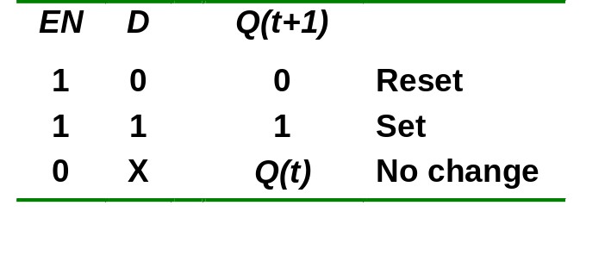
Gated D Latch
When EN is HIGH,
  D=HIGH → latch is SET
  D=LOW → latch is RESET
Hence when EN is HIGH, Q ‘follows’ the D (data) input.
Characteristic table:
When EN=1, Q(t+1) = D

Slide 18
D-Latche (Gated)
In a D-latch, the output follows the input when the clock is high.
D
R
Q
S
Q
When the clock is low, the output remains what it was on the falling edge of the clock.
En
clk
Clock
D
Q

Slide 19
Latch Circuits: Not Suitable
Latch circuits are not suitable in synchronous logic circuits.
When the enable signal is active, the excitation inputs are gated directly to the output Q. Thus, any change in the excitation input immediately causes a change in the latch output.
The problem is solved by using a special timing control signal called a clock to restrict the times at which the states of the memory elements may change.
This leads us to the edge-triggered memory elements called flip-flops.

Slide 20
References
A. Anand Kumar, “Fundamentals of Digital Circuits”, PHI, Fourth Edition.
S. Salivahanan and S. Arivazhagan, “Digital circuits and design”, Vikas Publishing House PVT Limited, Fifth edition.

